Slide 1
Team 6
7th Dec, 2023
COLLEGESTREET
Open source marketplace for students

Slide 2
Team 6
7th Dec, 2023
TODAY'S AGENDA
1
Introduction
Security
Testing
4
7
Project
UI
Demo
2
5
8
3
Backend
6
Frontend
9
Project

Slide 3
Team 6
7th Dec , 2023
PROJECT OVERVIEW
by Aishwarya Raja

Slide 4
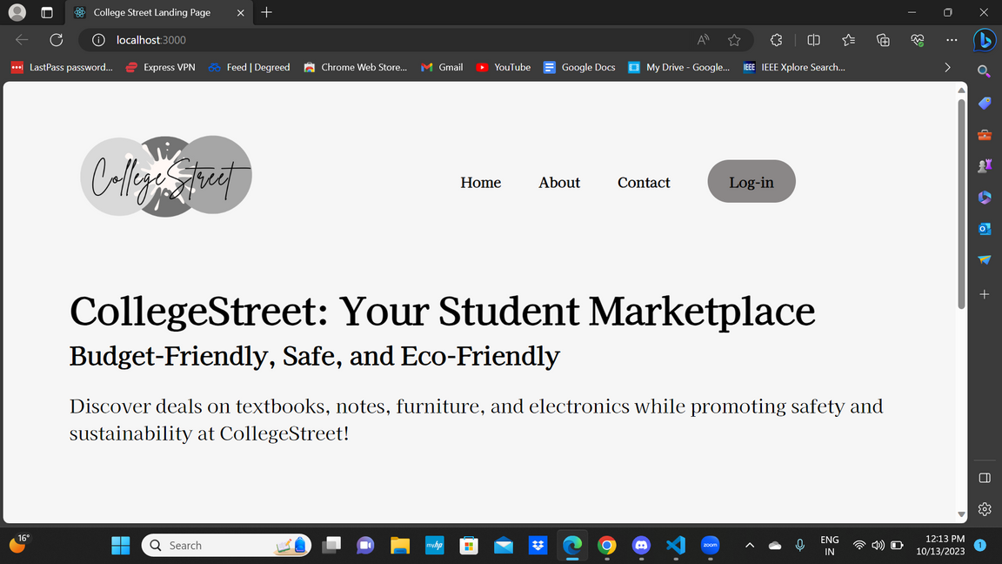
Team 6
7th Dec, 2023
INTRODUCTION
collegestreet.xyz
collegestreet is a opensource marketplace for students
This project aims to connect students to buy and sell school-needs. This community-led platform only allows verified students to sell and buy books, notes, and man ymore.

Slide 5
TEAM
collegestreet.xyz/team
Team Lead
Configuration Lead
Backend Lead
Theerarun Tubnonghee (Steve)
Aishwarya Raja
Subhajit Das
(Jeet)
QA Lead
Design Lead
Frontend Lead
Type your idea here.
Action 2
Chenyang Lyu
(Nick)
Nidhi Desai
Vedant Gupta
DevOps/Securiy Lead
Yin Xiancheng (Xanthus)

Slide 6
FEATURES
Copy a sticky note, then write your thoughts.
Copy a sticky note, then write your thoughts.
collegestreet.xyz/features
Any student can Register to our platform ( for now, only BU students are allowed)
In-build verification process to keep the community safe.
Users can create a post to sell an item ( i.e. Books, Notes or anything that is needed in student life)
Users can Delete and/or update their posts
Users can search for any specific item on the marketplace to buy it
Users can filter through the pool of books, notes, and whatnot
User chat system to interact with your buyer/seller

Slide 7

PROGRESS
collegestreet.xyz/weworkedhard
In 3 Iterations, we worked on 84 issues ( 37 closed already, 47 are about to be closed)
We solved a total of 17 bugs which are untracked - shoutout to Vedant and Jeet
We did manual testing for both backend and frontend code
We wrote unit testing for each feature when we were not happy with our manual testing result.
Decided on a new contribution standard to keep everyone in sync with each other work
We learned and experimented with new technologies

Slide 8
MAJOR RELEASES
collegestreet.xyz/changelog
Build in-house Authentication system - by Jeet
Migrated our authentication from Auth0 - by Jeet
User Registration REST API - by Aishwarya
User Profile Info REST API - By Aishwarya
Registration restriction to BU email (critical) - by Aishwarya
Create product REST APIs and Cloudinary CDN - by Xanthus and Jeet
Frontend code Deployment on Vercel (WIP) - by Xanthus
backend Infra Deployment on DigitalOcean- By Jeet
Redesign create post model - by Vedanth

Slide 9
MAJOR RELEASES
collegestreet.xyz/changelog
Landing page - by Steve and Nidhi
Implemented Search feature v0 - by Vedant
Login and Registration v0 - by Vedant
New Login and Registration - by Vedanth and Steve
Team page (WIP) - by Nick
Chat feature - by Nick
Filter feature v0 - by Vedant
Create/update/ delete post - by Steve, Nick, Vedant
E2E testing using Cypress- by Nidhi
Pytest - by Nidhi and Jeet

Slide 10
MISC
collegestreet.xyz/misc
wrote 2498 lines of code overall
we are serious - we bought a domain and made it live on the internet
Setup automatic testing
Learned technologies like Django-rest framework, pytest, deployment like technologies

Slide 11
Team 6
7th Dec , 2023
BACKEND
by Subhajit Das (Jeet)

Slide 12
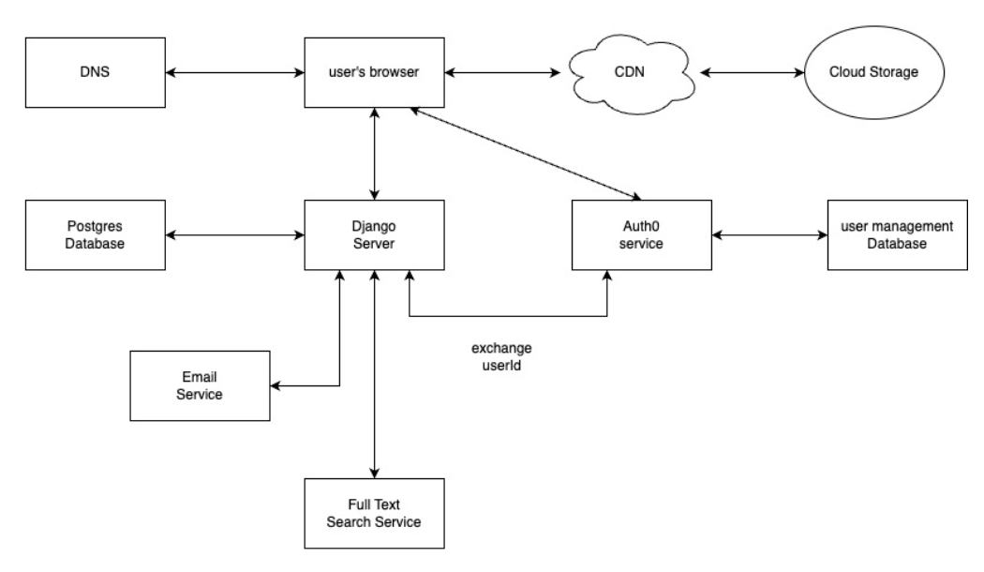
ARCHITECHTURE

Slide 13
THIRD-PARTY SERVICES
collegestreet.xyz/usedservies
Supabase - Database Hosting
Vercel - Client hosting
DigitalOcean - Backend infra hosting
Cloudinary as our CDN
Auth0 - Authentication ( Dropped it later)

Slide 14
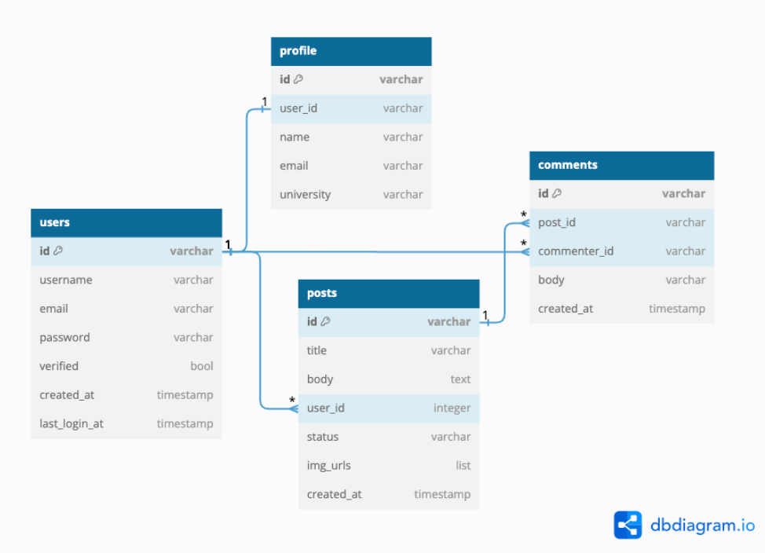
DATABASE
DESIGN
Profile
users
posts
comments

Slide 15
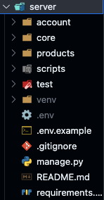
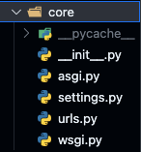
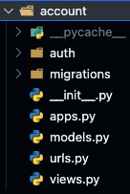
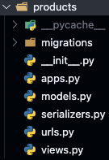
FOLDER ARCHITECHTURE
pages
/server
core
account
products

Slide 16
MAJOR APIS
collegestreet.xyz/apis
POST /users/register
POST /users/login
POST /users/forgetpassword
GET /users/user/info
GET /products
POST /product/create
POST /product/edit
POST /product/delete

Slide 17
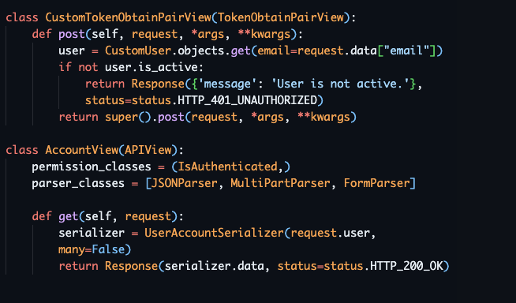
CODE EXAMPLES
api.collegestreet.xyz/users/login

Slide 18
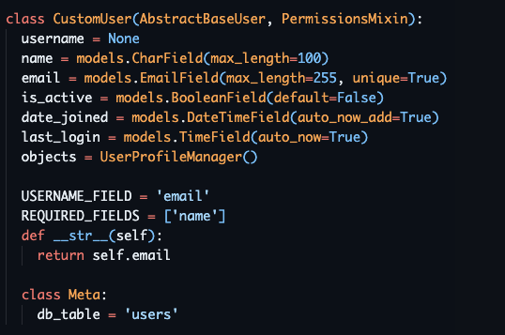
CODE EXAMPLES
api.collegestreet.xyz/users/login

Slide 19
DEVOPS WORKS
collegestreet.xyz/apis
Github workflow for Pull request - thanks to Aishwarya
feature branch contribution standard and branch security - thanks to Aishwarya
Webapp deployment and management on Vercel - Xantus
Database Migration - Jeet and Xantus
Backend Infra deployment on DigitalOcean - Jeet

Slide 20
Team 6
7th Dec , 2023
SECURITY
by Yin Xiancheng (Xanthus)

Slide 21
SECURITY DESIGN
collegestreet.xyz/security
User Authentication
Registration
Users provide .edu email address only and create a password.
Email Verification
An email verification link is sent to the user’s edu email address. User verifies the email using provided link in the email to activate the account.
Password
Passwords are securely stored in the system using cryptographic hashing.

Slide 22
SECURITY DESIGN
collegestreet.xyz/security
Data Security
Password
Strong passwords are enforced.
Data Storage
Secure database.
Data Transmission
Secure connection HTTPS.
Session Management
jwtToken.

Slide 23
Team 6
7th Dec , 2023
FRONTEND
OVERVIEW
by Theerarun Tubnonghee (Steve)

Slide 24
Team 6
7th Dec , 2023
USER INTERFACE
DESIGN
by Theerarun Tubnonghee (Steve)

Slide 25

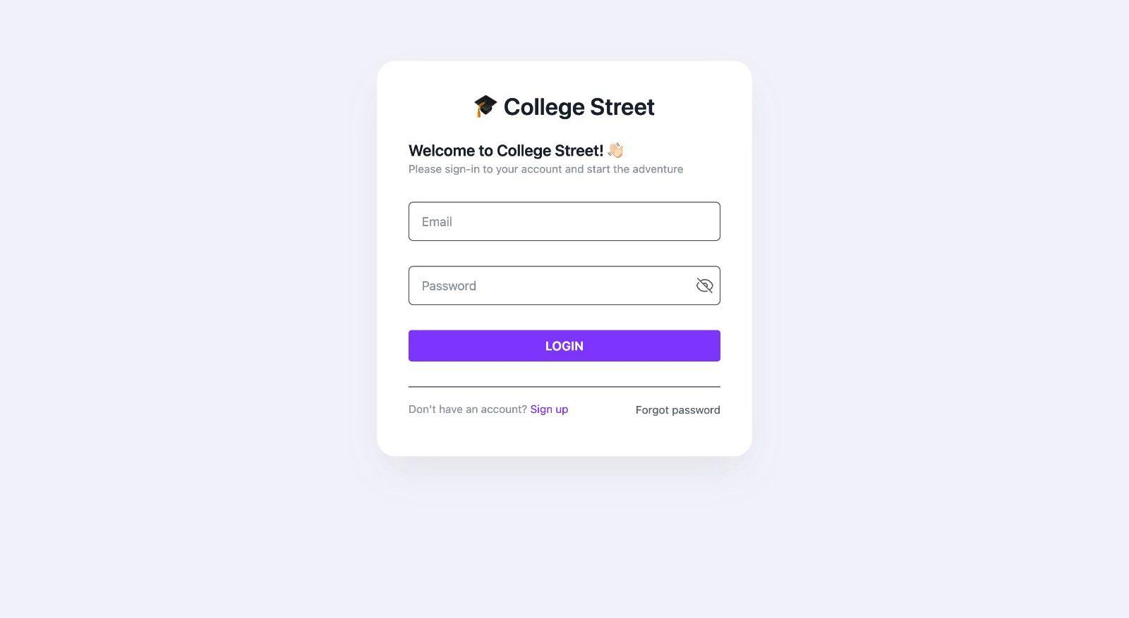

Slide 26
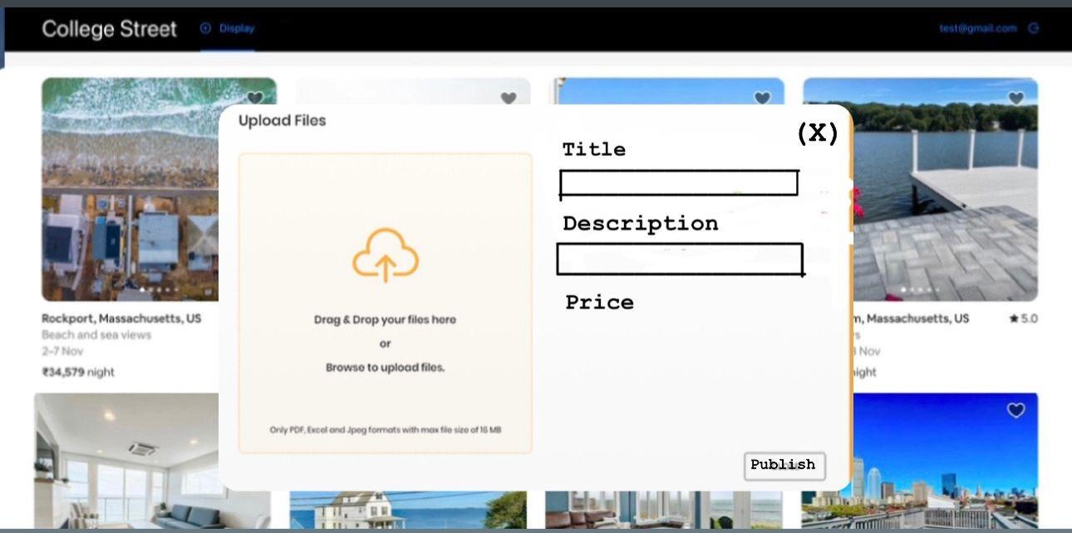

Slide 27
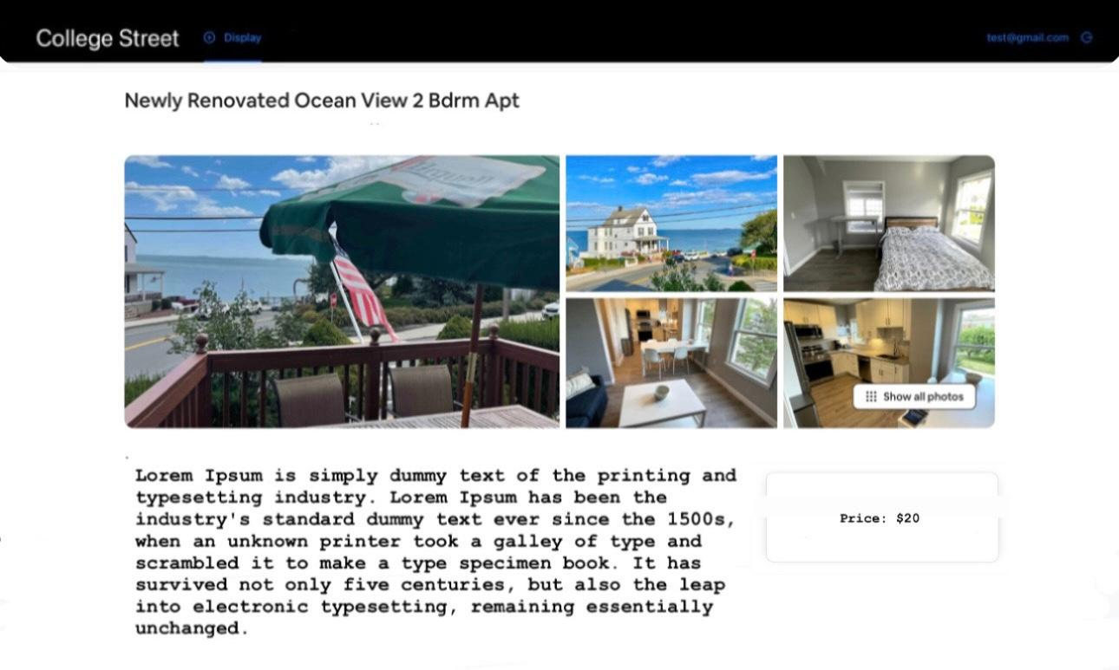

Slide 28
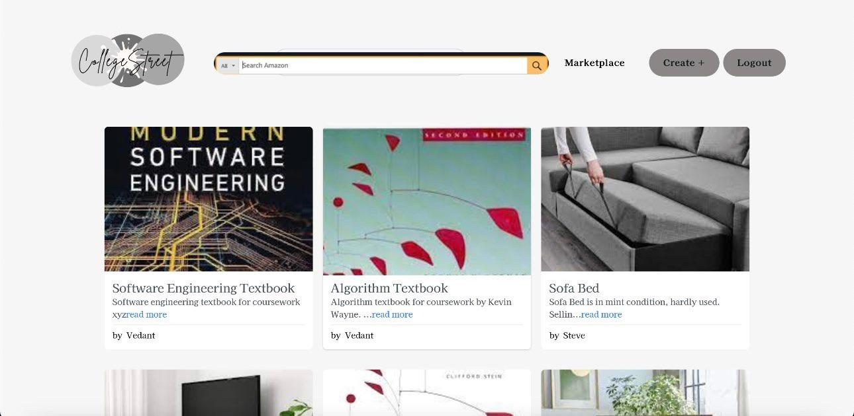

Slide 29
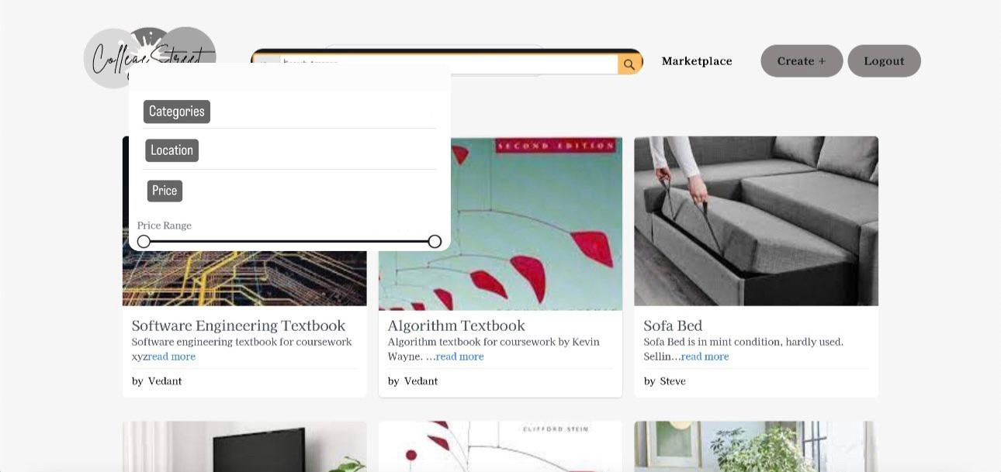

Slide 30
FRAMEWORK
collegestreet.xyz/usedFramework
ReactJS for our UI/UX design
React internally uses Flux design pattern.

Slide 31
Team 6
7th Dec , 2023
FRONTEND STRUCTURE
by Theerarun Tubnonghee (Steve)

Slide 32
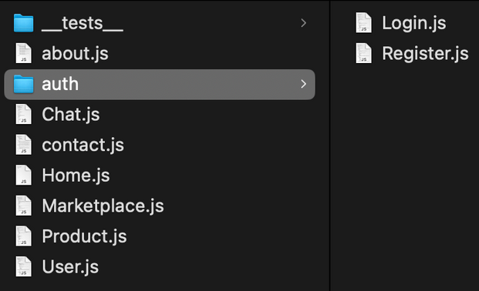
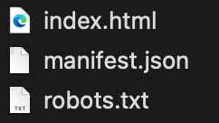
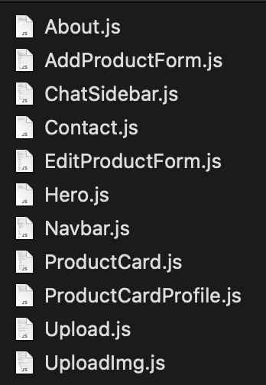
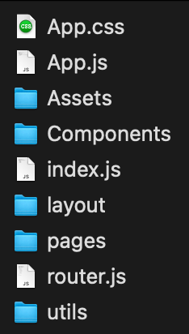
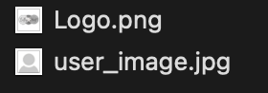


FRONT END STRUCTURE
pages
public
components
src
assets
utils
layout

Slide 33
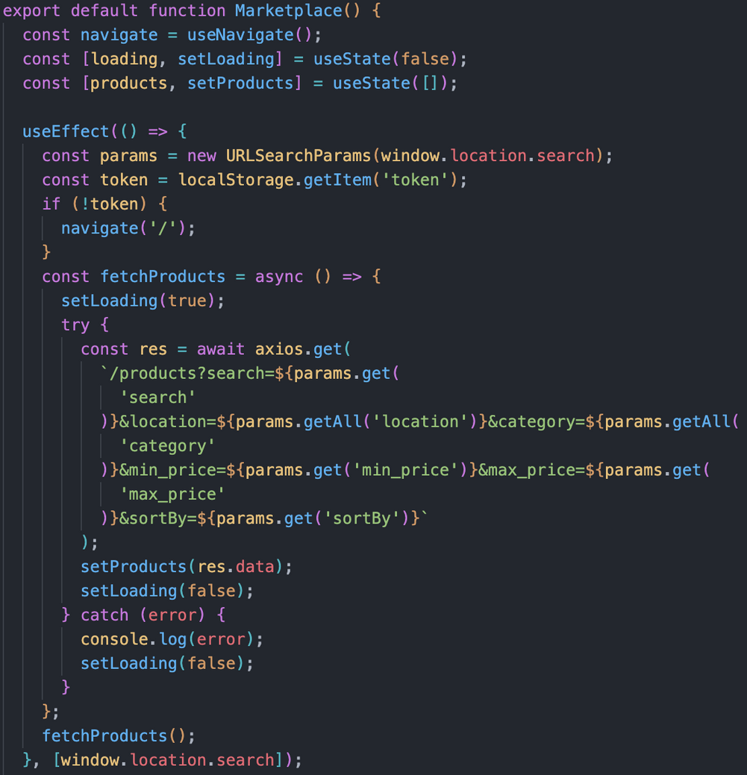
CODE EXAMPLES
collegestreet.xyz/marketplace
API
/PRODUCTS?SEARCH
TO RETRIEVE
ALL AVAILABLE
POSTS
OR WITH FILTERS

Slide 34
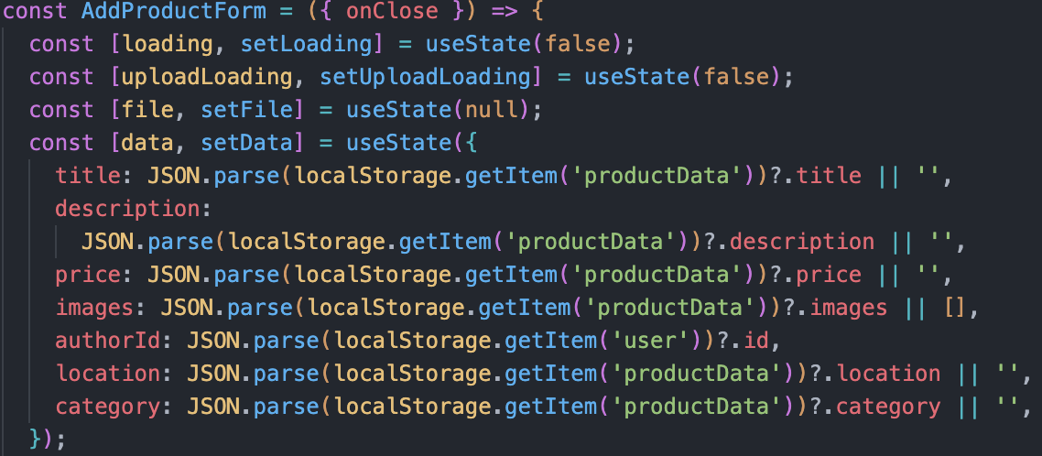
CODE EXAMPLES
collegestreet.xyz/addProductForm

Slide 35
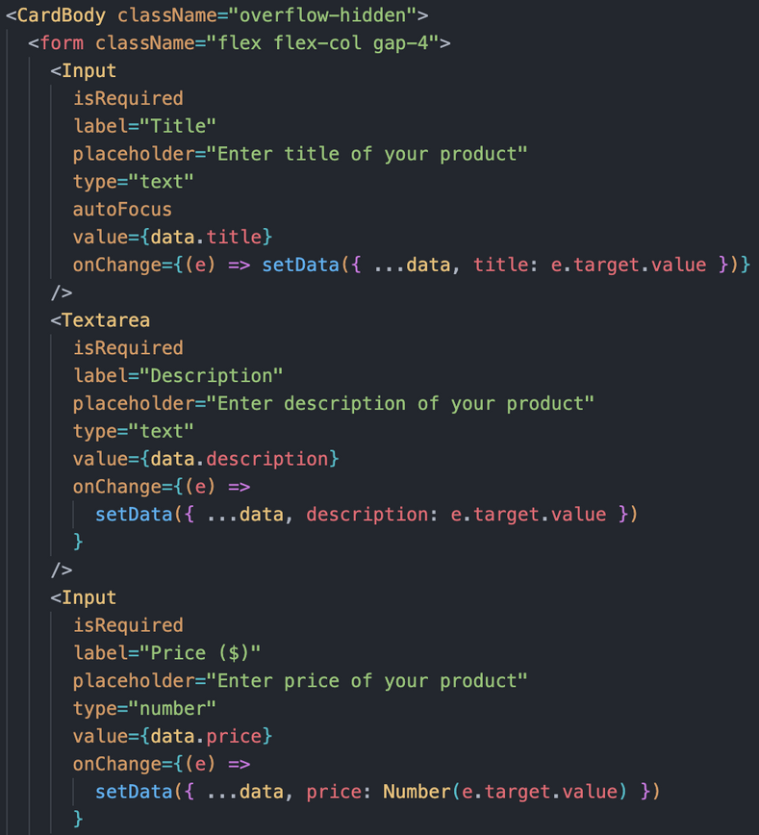
CODE EXAMPLES
collegestreet.xyz/addProductForm
LISTENING TO ONCHANGE
IN THE INPUT FIELDS
SETDATA

Slide 36
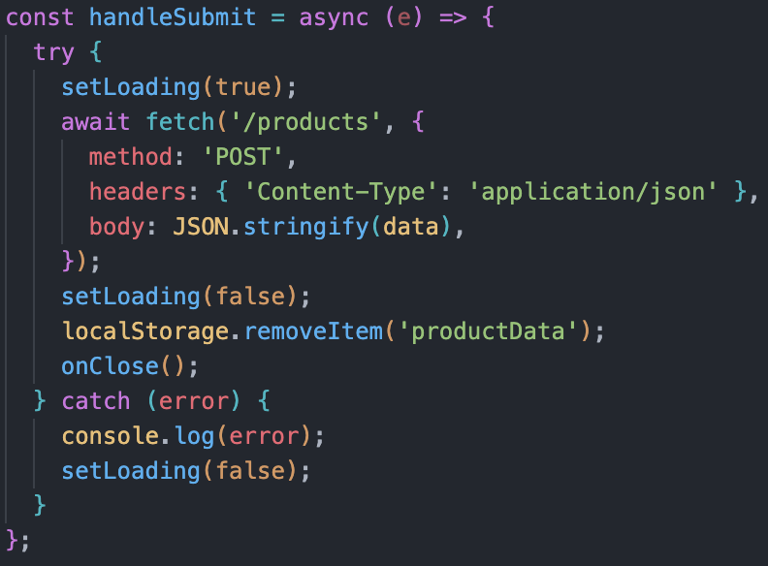
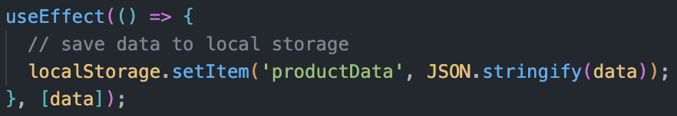
CODE EXAMPLES
collegestreet.xyz/addProduct
POST SUBMISSION
METHOD POST
API
/PRODUCTS

Slide 37
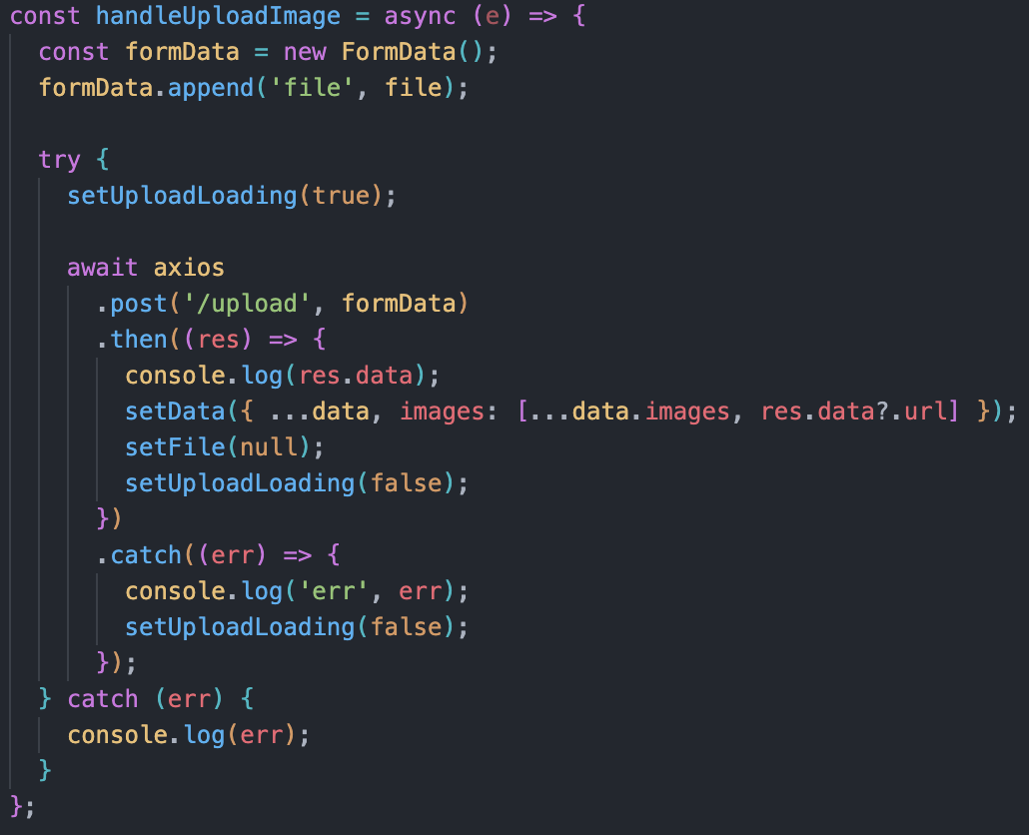

CODE EXAMPLES
collegestreet.xyz/uploadImage
UPLOAD IMAGE
/UPLOAD
cloudinary

Slide 38
Team 6
7th Dec , 2023
FRONTEND
IMPLEMENTATION
by Chenyang Lyu

Slide 39
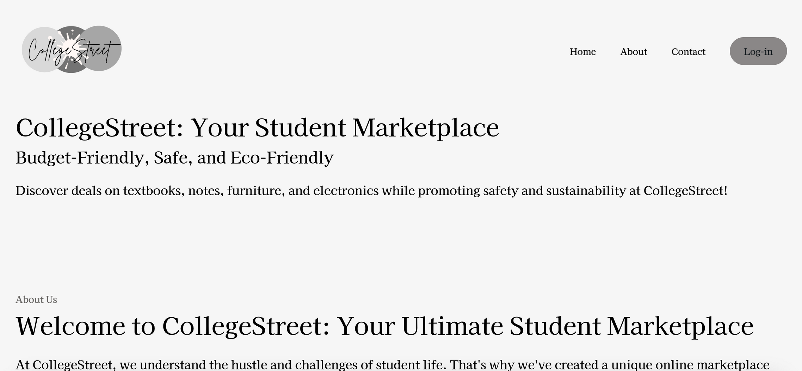

Slide 40
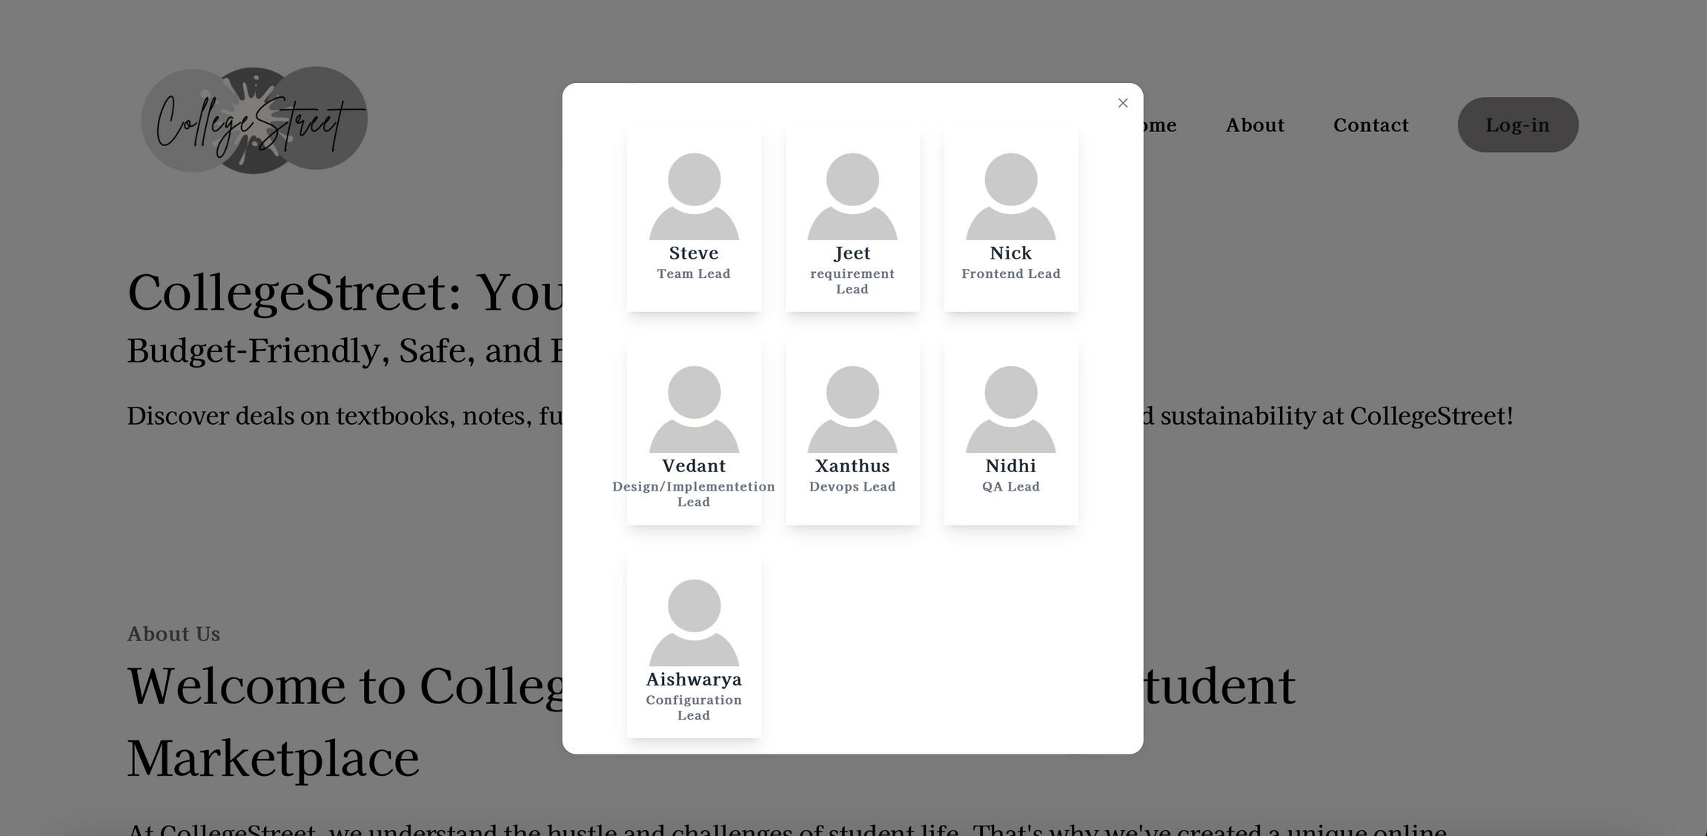

Slide 41
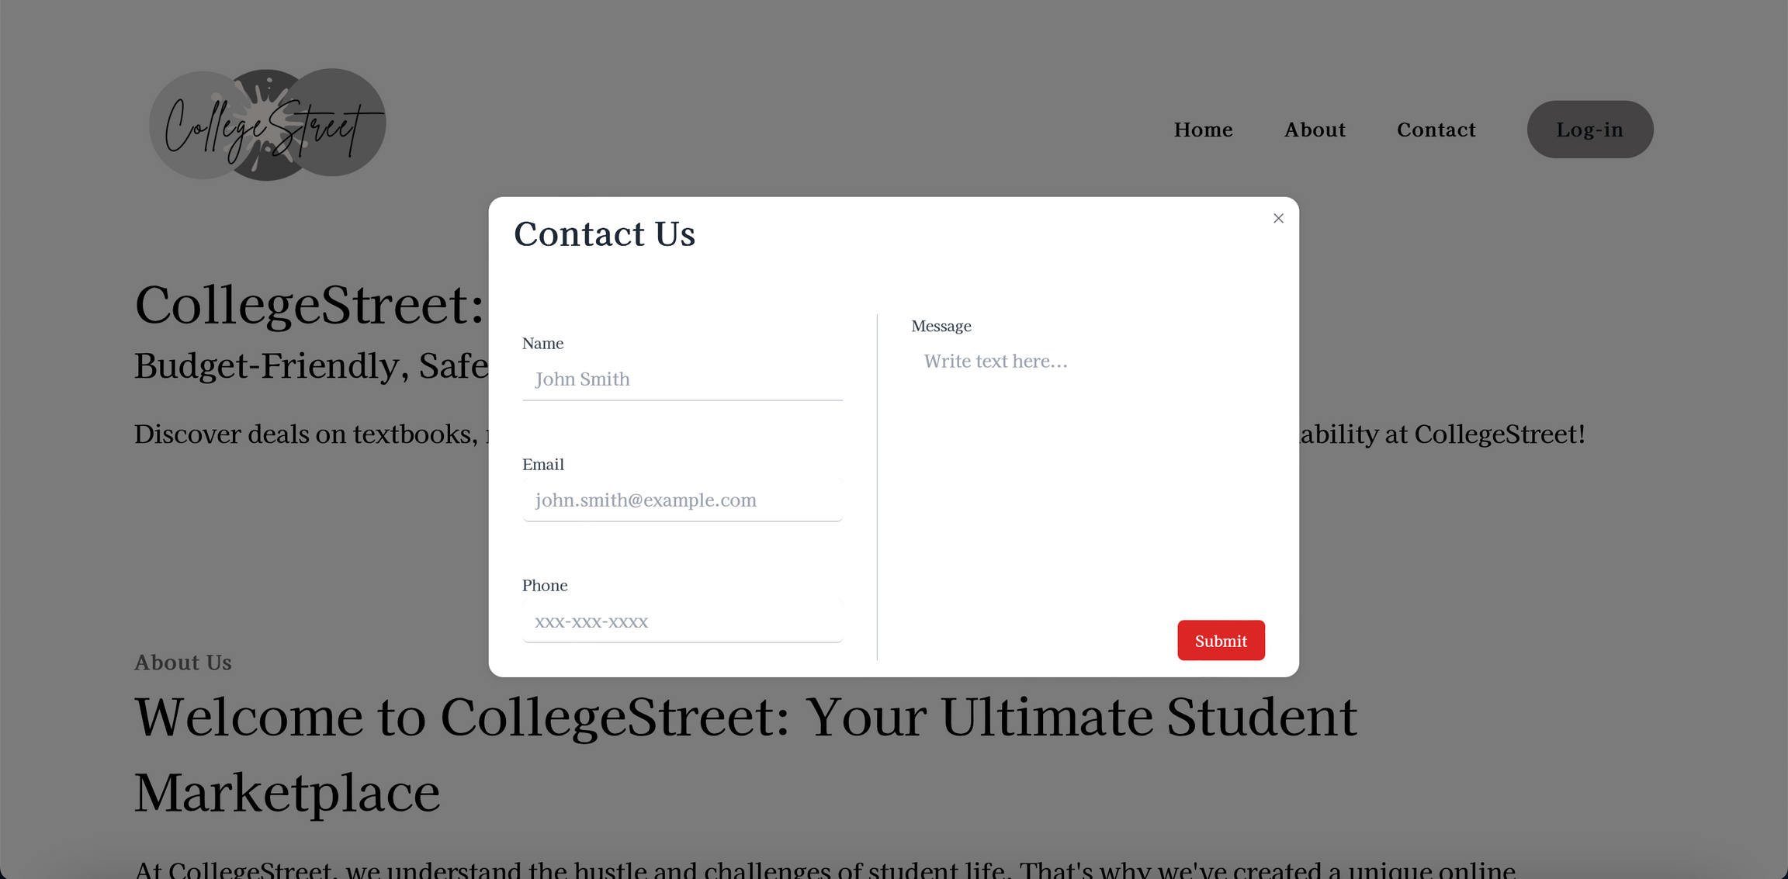

Slide 42
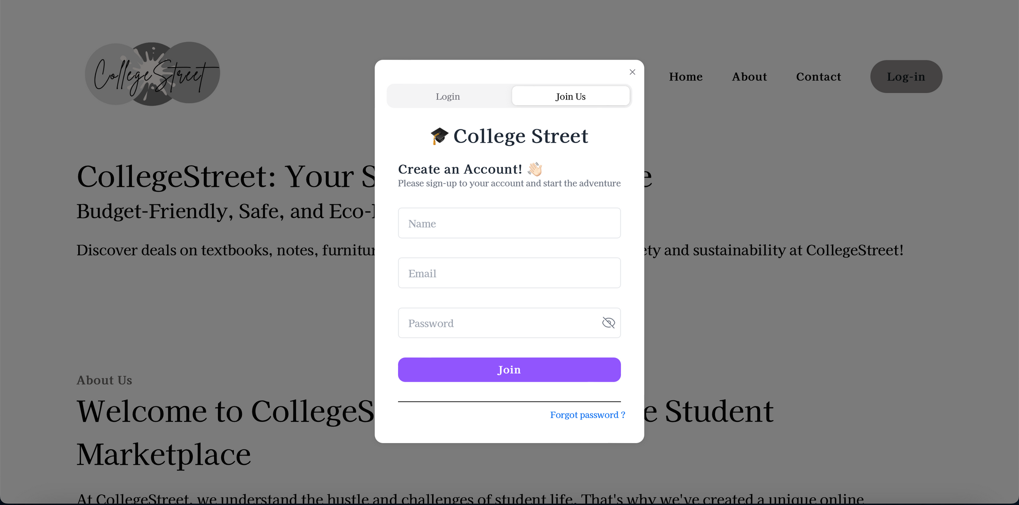

Slide 43
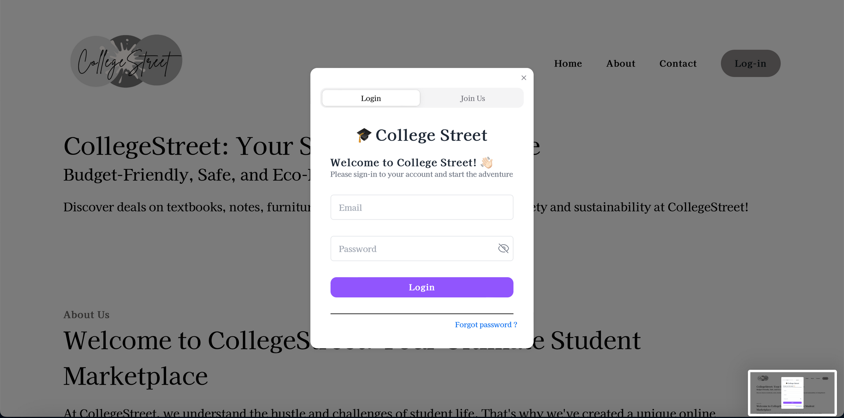

Slide 44
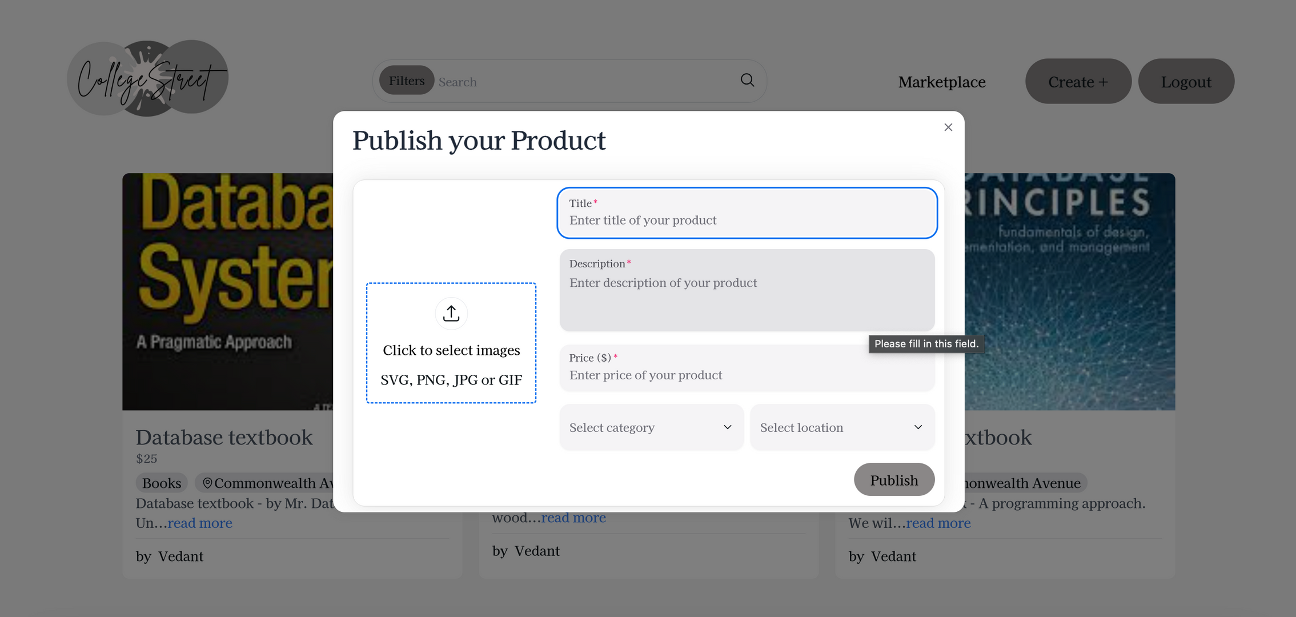

Slide 45
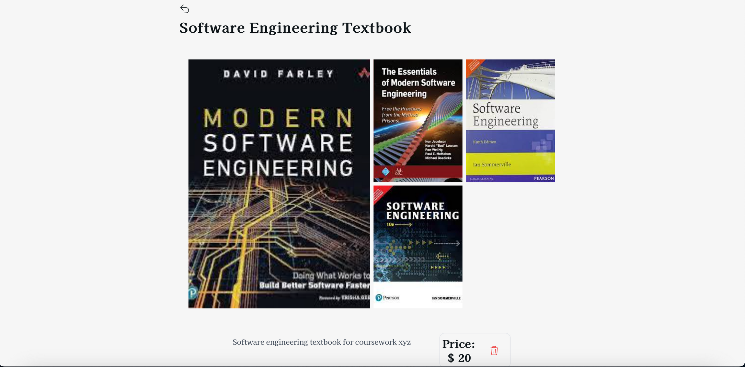
Before

Slide 46
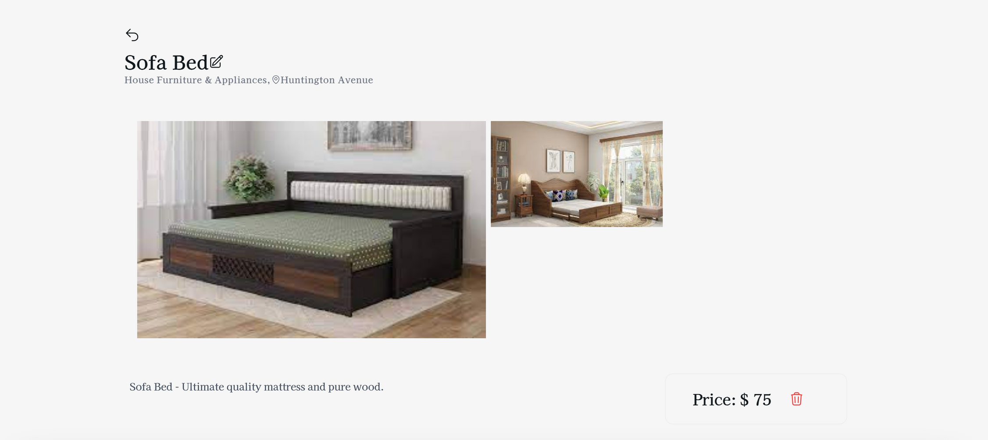
After

Slide 47
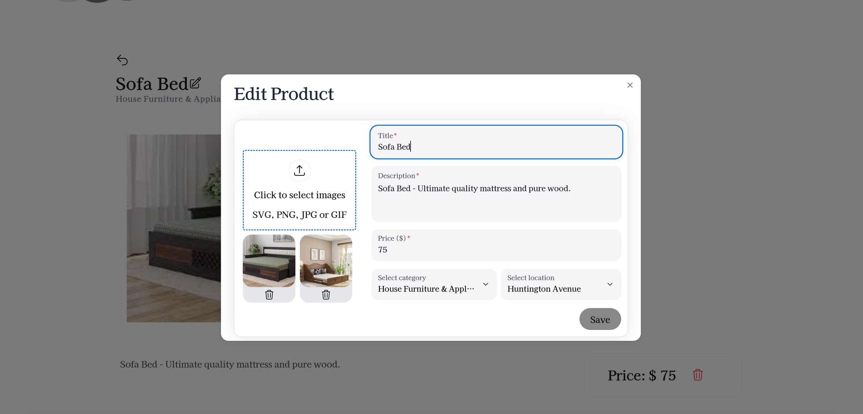

Slide 48
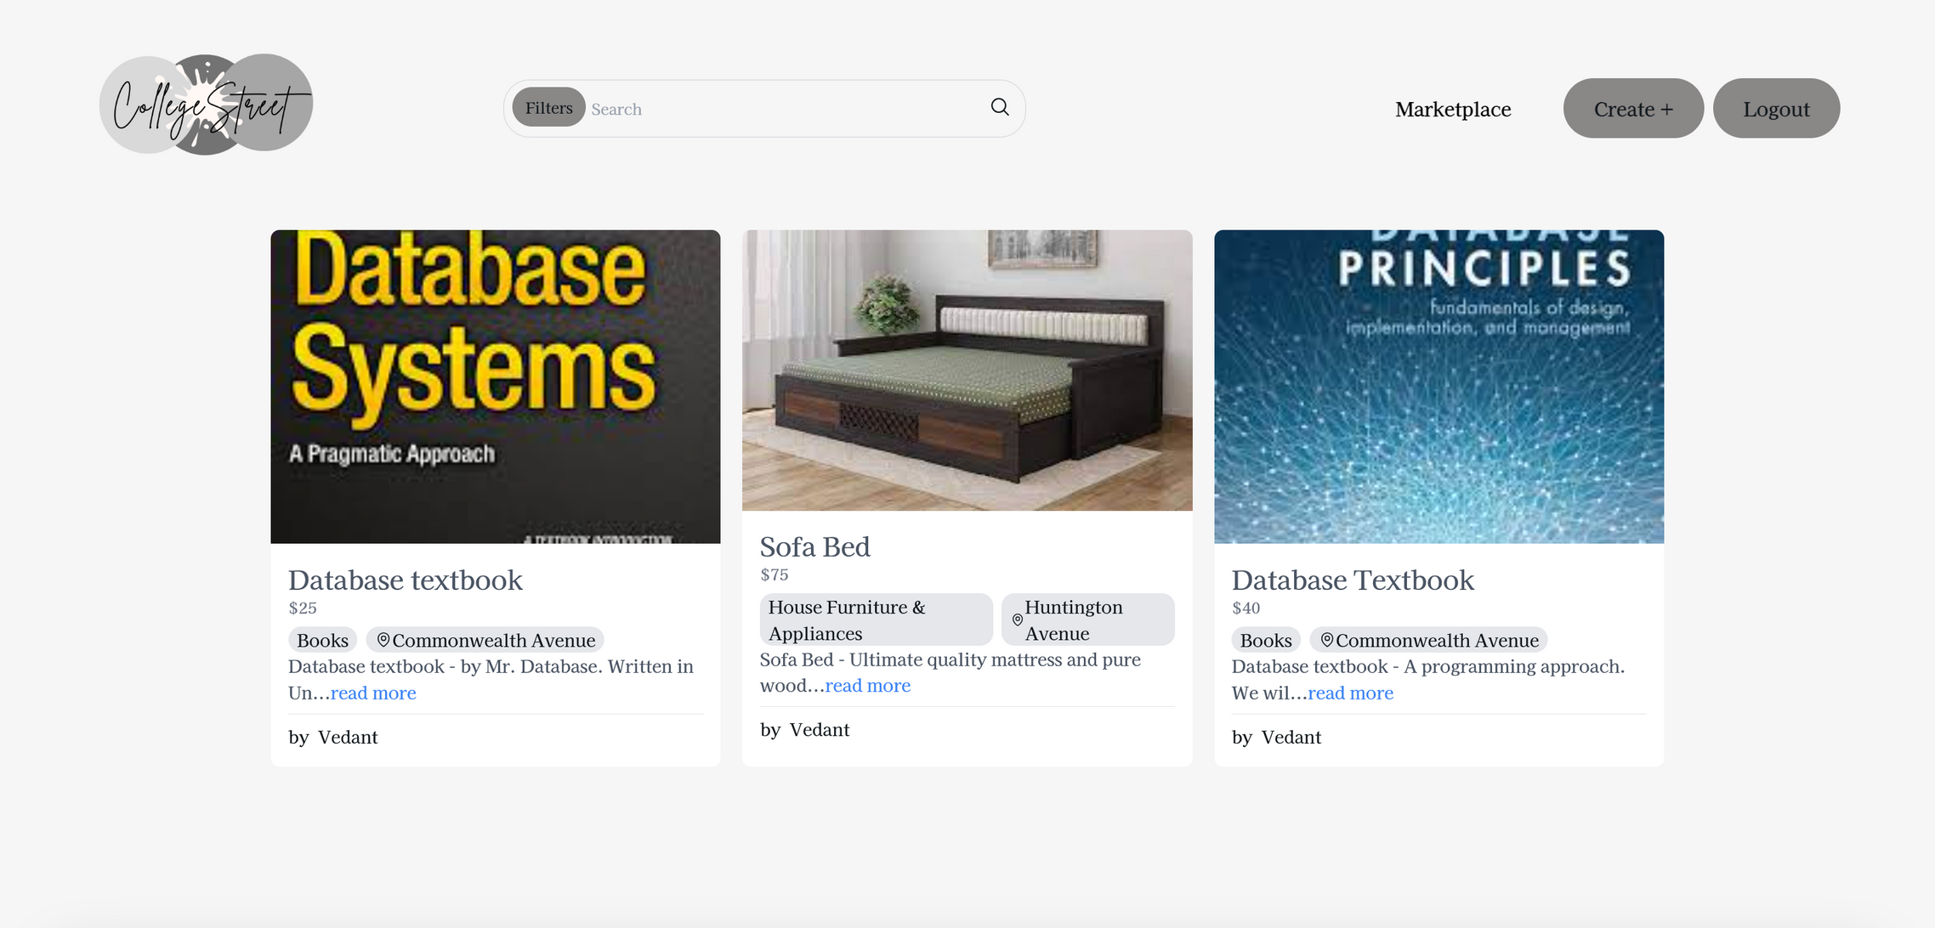

Slide 49
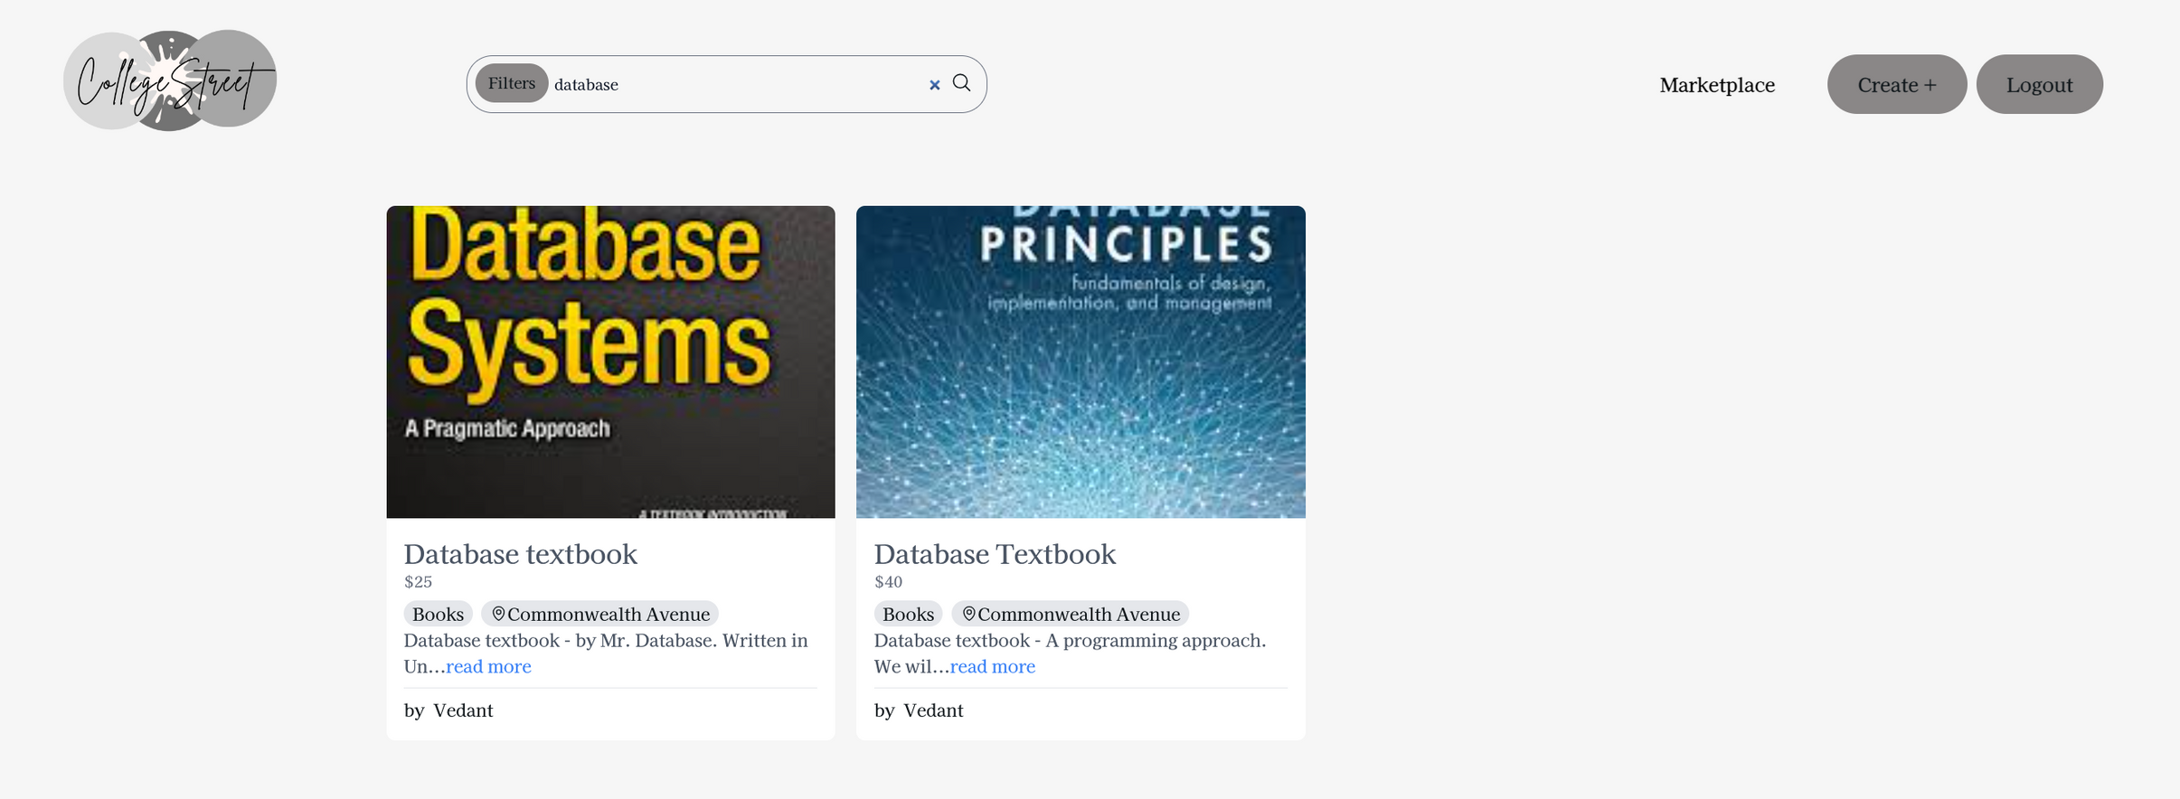

Slide 50
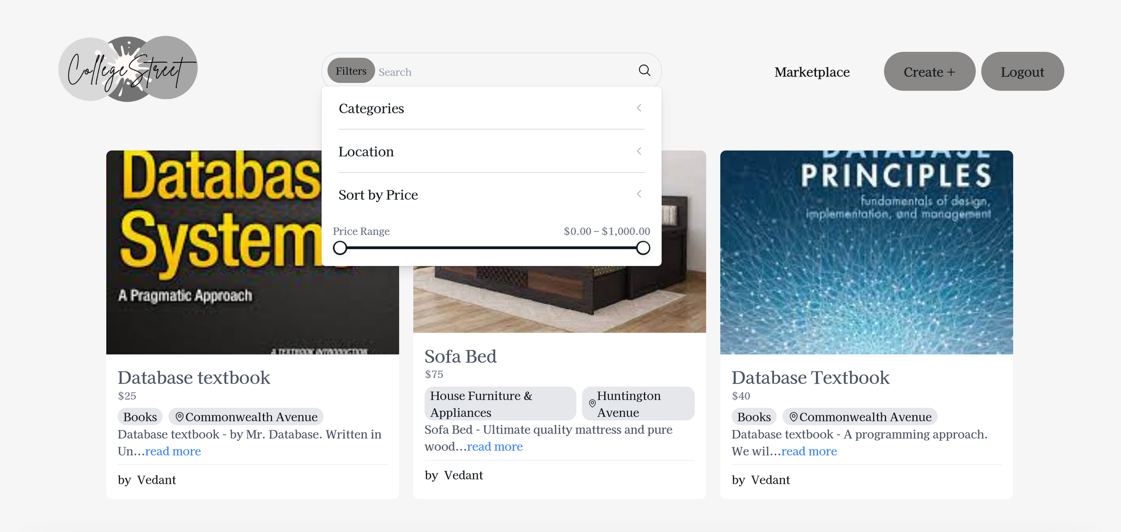

Slide 51
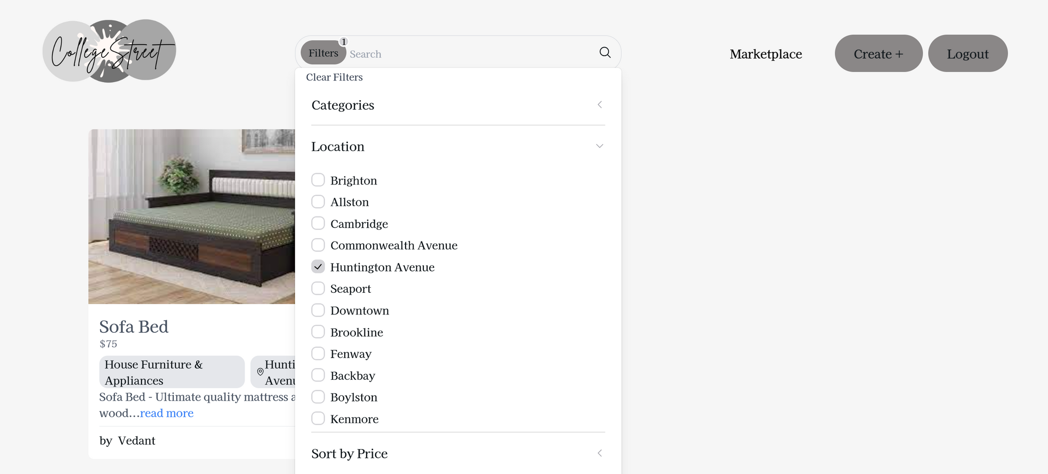

Slide 52
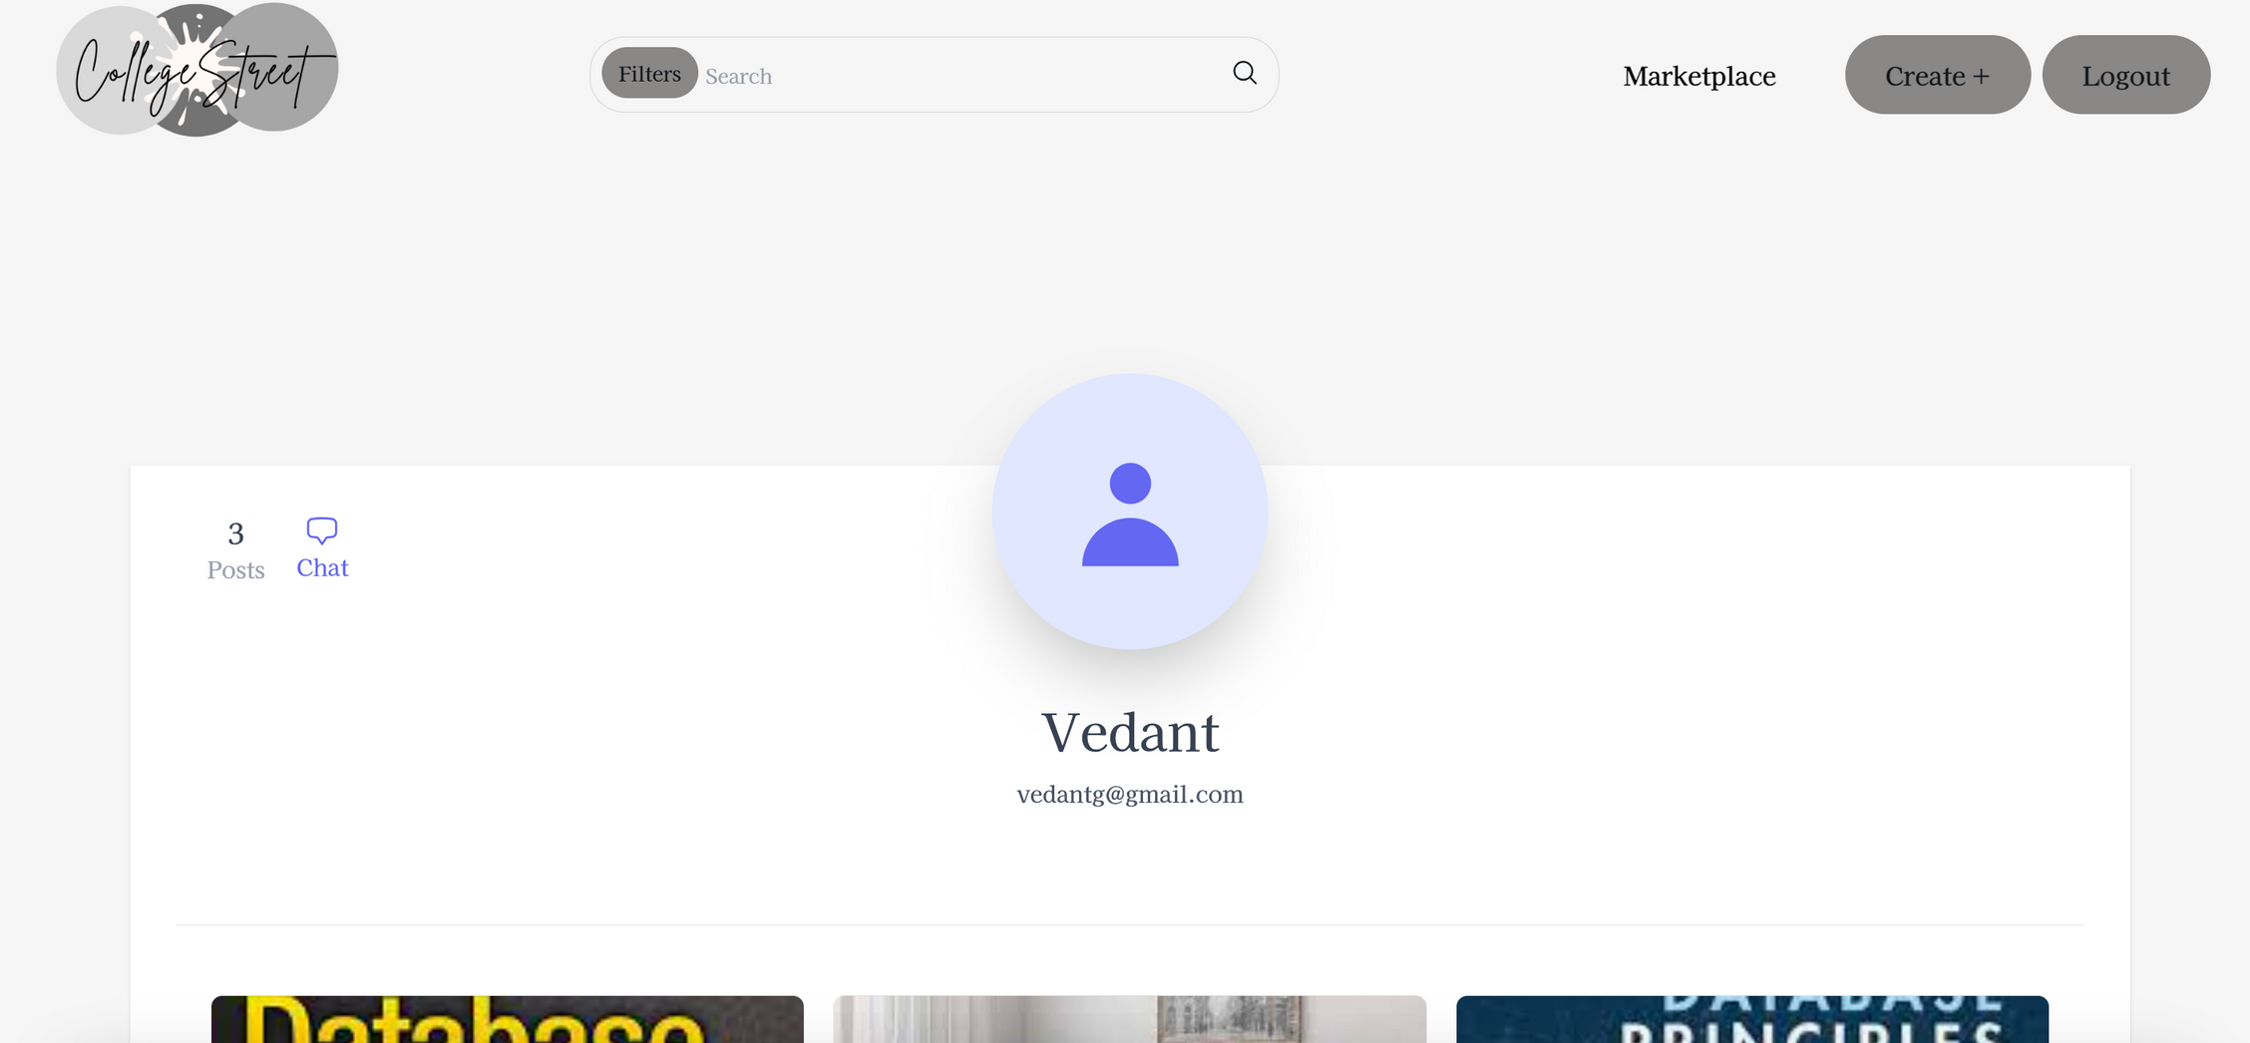

Slide 53
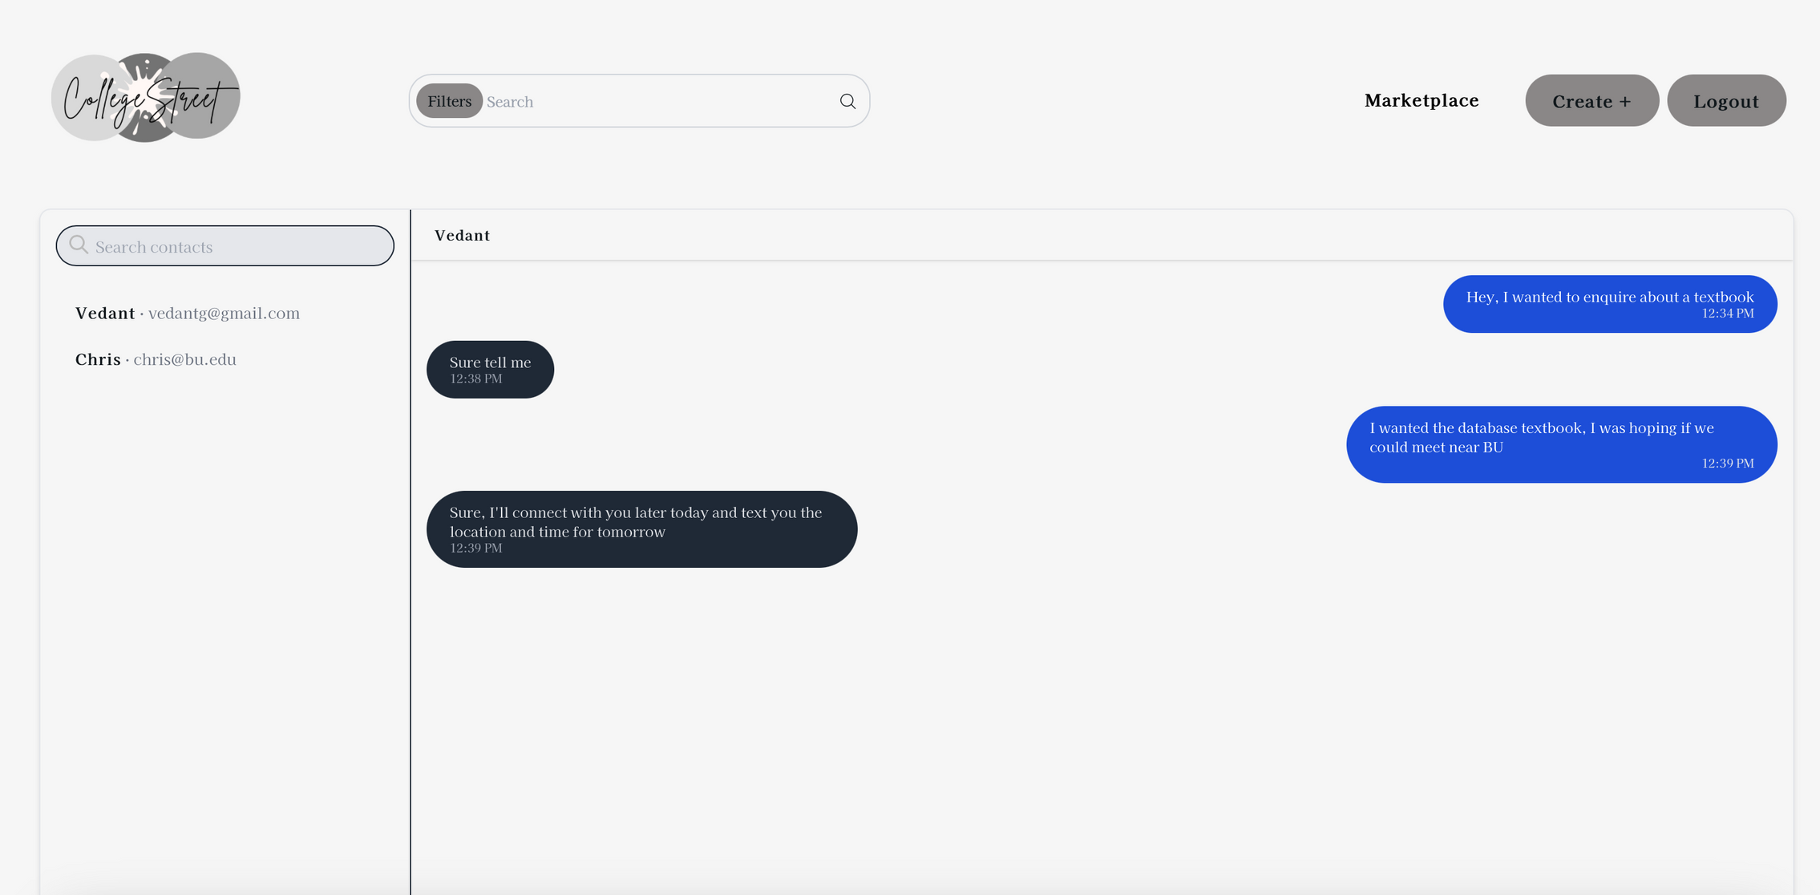

Slide 54
Team 6
7th Dec , 2023
TESTING
by Nidhi

Slide 55
Testing
types of testing,
test case examples,
testing metrics,
such as testing coverage, test pass rate, defect density or fix rate

Slide 56
Types of Testing
Manual Testing
Unit Testing
Acceptance Testing
Automation Testing
Component Testing
E2E testing

Slide 57
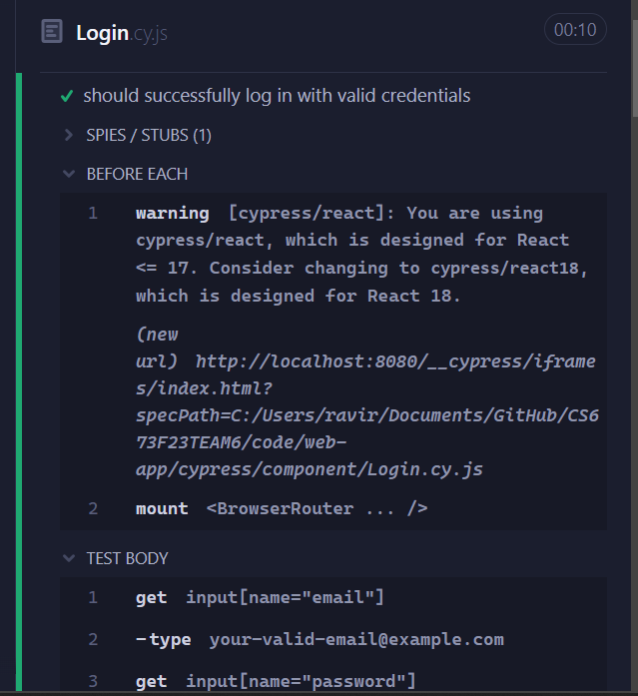


Slide 58
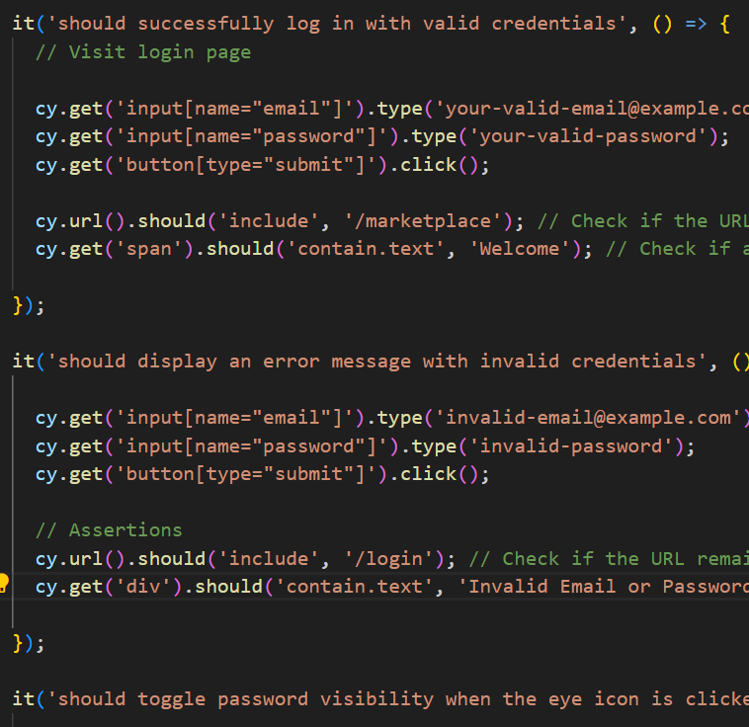
Component Testing
Registration
Login
Marketplace
Add Product form
Product
User
Contact Us
Logout
Direct Messaging

Slide 59
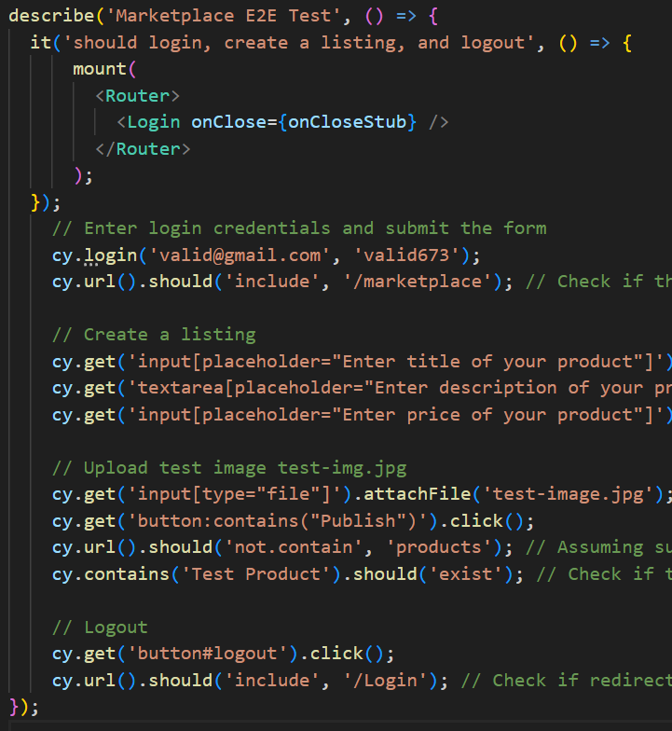
E2E Testing
User can successfully log in and log out.
Users can create a new product listing.
Users can delete their Product listing
Users can search for products on the marketplace.

Slide 60
Test CRUD operations on Product model
Tools: unittest, Django's APIClient, status, reverse.
Test Setup
Initialize test user and authenticate with APIClient.
Prepare Product test data.
Test Cases Overview
Create Product: Validates product creation.
Retrieve Product List: Ensures retrieval functionality.
Update Product: Tests product update capability.
Delete Product: Confirms product deletion process.

Slide 61
Test Coverage
Manual Testing- 100%
Component Testing- 90%
E2E tesing-85%
Test Pass Rate
Manual Testing- 92%
Automation Testing- 88%
Defect Density and Fix Rate

Slide 62

Team 6
7th Dec , 2023
DEMO
by Vedant Gupta

Slide 63
COLLEGESTREET
7th DEC 2023
THAT'S A WRAP!
Thank you for participating.

